Slide 1
Applications of Potentiometers
Dr.K.Prabhu
Associate Professor/EIE

Slide 2
Applications of Potentiometers
In addition to the measurement of unknown voltage, the potentiometer can also be used to measure the current and power.
Other than measuring voltage, current, and power, the potentiometers are mainly used for calibration of voltmeters, ammeters and wattmeter.

Slide 3
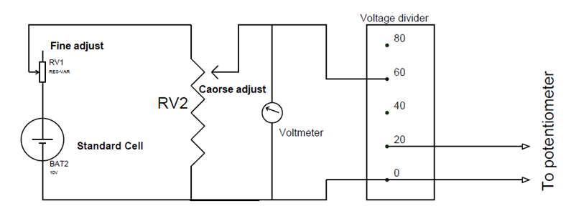
Calibration of Voltmeter using Potentiometer

Slide 4
Calibration of Voltmeter
The most important component for the calibration process is a suitable stable DC voltage supply.
This is because any fluctuations in supply voltage will cause an error in the voltmeter calibration thereby leading to an entire failure.
So standard voltage cell with stable terminal value is taken as a source and connected in parallel with voltmeter which needs to be calibrated.
The two trim pots ‘RV1’ and ’RV2’are used for adjusting the voltage that is to appear across the voltmeter.

Slide 5
Calibration of Voltmeter
A voltage ratio box is also connected in parallel with the voltmeter to divide the voltage across the voltmeter and get appropriate value suitable for connecting the potentiometer.
This ratio box is used to step-down the voltage to a suitable value so that the potentiometer can easily read the voltage.
With the entire setup it is ready for testing the accuracy of the voltmeter.
So to start, just provide the power to the circuit to get a reading on the voltmeter and an unknown voltage at the voltage ratio box output.
Now, use a calibrated potentiometer to measure this unknown voltage.

Slide 6
Calibration of Voltmeter
After getting the potentiometer reading, check whether the potentiometer reading matches the voltmeter reading.
Since potentiometer measures the true value of voltage, if the potentiometer reading does not match with the voltmeter reading, then a negative or positive error is indicated.
And for correction, a calibration curve can be drawn with the help of the readings of voltmeter and potentiometer.
Also, for accuracy of measurements, it is necessary to measure voltages near the maximum range of the potentiometer as far as possible.

Slide 7
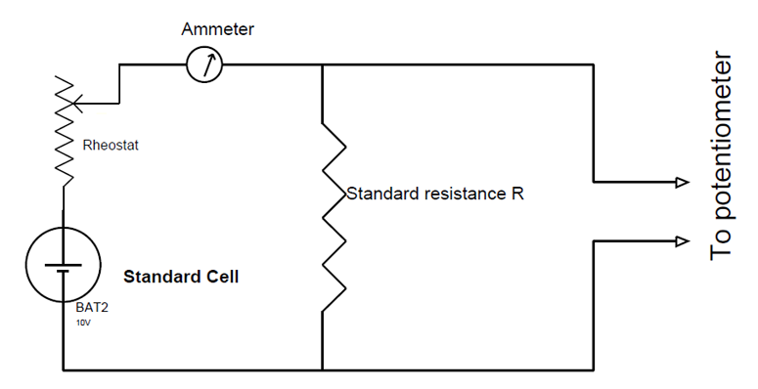
Calibration of Ammeter using Potentiometer

Slide 8
Calibration of Ammeter
Use a suitable stable DC supply voltage to avoid the errors in calibration which do not produce voltage fluctuations.
A rheostat is used for adjusting the magnitude of the current flowing through the entire circuit.
Also, a standard resistance ‘R’ of suitable value with sufficient current-carrying capacity is placed in series with the ammeter (which is under calibration) for getting a voltage parameter which relates to the current flowing in the circuit.

Slide 9
Calibration of Ammeter
Now after the power is turned ON, a current ‘I’ flows through the entire circuit and with this current flow reading will be generated by the ammeter present in the loop. Also, a voltage drop will take place across the standard resistance ‘R’ because of this current flow.
Now we will use a potentiometer to measure the voltage across the standard resistor and then use ohms law to calculate the current through the standard resistance.

Slide 10
Calibration of Ammeter
That is the current I=V/R Where V=voltage across the standard resistor measured by the potentiometer, And R=resistance of a standard resistor.

Slide 11
Calibration of Ammeter
Since we are using the standard resistor, the resistance will be accurately known and the voltage across the standard resistor is measured by the potentiometer.
The calculated value will be the accurate value of the current flowing through the loop.
Then compare this calculated value with ammeter reading to check the accuracy of the ammeter.
If there are any errors, we can make necessary adjustments for the ammeter to rectify the errors.

Slide 12
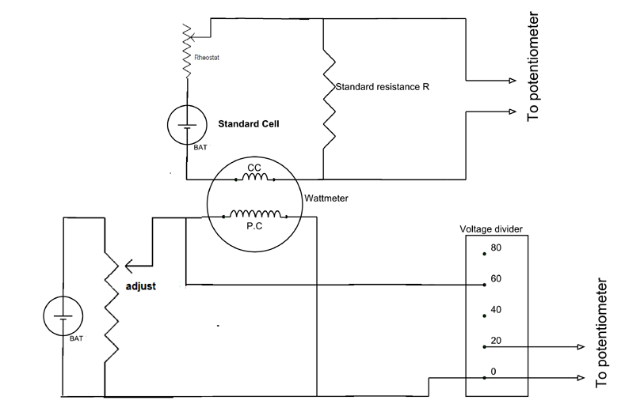
Calibration of Wattmeter using Potentiometer

Slide 13
Calibration of Wattmeter
Use two suitable stable DC voltage power supplies as sources.
Usually, low voltage supply is connected in series with the current coil of a wattmeter and a moderate voltage supply is connected to the potential coil of the wattmeter.
A rheostat in the top circuit is used for adjusting the magnitude of the current flowing through current coil.
Trim pot in the bottom circuit is used for adjusting the voltage across the potential coil.

Slide 14
Calibration of Wattmeter
A trim pot is preferred for adjusting the voltage and rheostat is preferred for adjusting the current in a circuit.
Also, a standard resistance ‘R’ of suitable value and sufficient current-carrying capacity is placed in series with the current coil of the wattmeter. And this standard resistance will generate a voltage drop across it when current flows in the current coil circuit.

Slide 15
Calibration of Wattmeter
After the power is turned ON we will get two unknown voltage readings, one is at the voltage divider output and the other is across the standard resistance ‘R’.
Now if a potentiometer is used to measure the voltage across the standard resistor then we can use ohms law to calculate the current through the standard resistance.
Since the current coil is in series with the standard resistance the calculated value also represents the current going through the current coil.
In a similar way, use the potentiometer second time to measure the voltage across the potential coil of the wattmeter.

Slide 16
Calibration of Wattmeter
Now that we have measured the current through current coil and voltage across the potential coil using a potentiometer, we can calculate the power as
Power P = Voltage reading x Current value.

Slide 17
Calibration of Wattmeter
After calculating we can compare this calculated value with wattmeter reading to check for errors. Once the errors are found, make necessary adjustments to the wattmeter to adjust the errors.
This is how a potentiometer can be used to calibrate Voltmeter, Ammeter, and wattmeter to get accurate readings.

